Slide 1
Team 3
Yelp Review Analysis
Cole Brown, Usman Jadoon, Hussein Mawaw, Paola Dumbi & Ingara Mayeke
Spring 2023 - IFI 8450 - Scalable Data Analytics
Final Project Presentation
April 24th, 2023
​

Slide 2
Background
What’s Yelp?
An online platform that allows users to rate and review businesses.
Crucial tool that provides business with an opportunity to engage with customers and receive feedback on their performance.
However, not all Yelp reviews are created equal, and business are often looking for ways to improve their ratings and attract more customers.

Slide 3
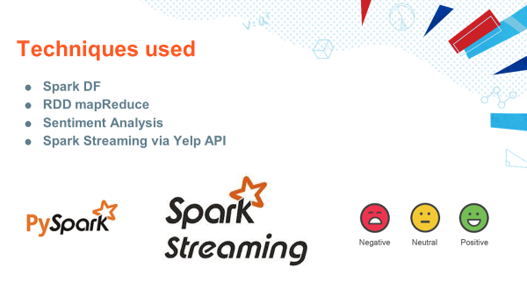

Slide 4

Project Purpose
To identify specific words that are indicative of whether a review is positive or negative, to help businesses gain valuable insight into the factors that influences customers satisfaction and use this information to improve their performance.
Why is this problem important?
As not all Yelp reviews are created equally, this would give the different business an insight about the type of reviews they need to receive better Yelp ratings.

Slide 5



Implementation and Methodology
Categories: 14 Total Business Categories
Food - {Mexican, Indian, Delis, Sushi, Pizza, Mediterranean}
Travel - {Hotels, Casinos, Car Rentals, Resorts}
Beauty/Spa - {Hair Salons, Barbers, Massage, Tattoo Parlor}

Slide 6
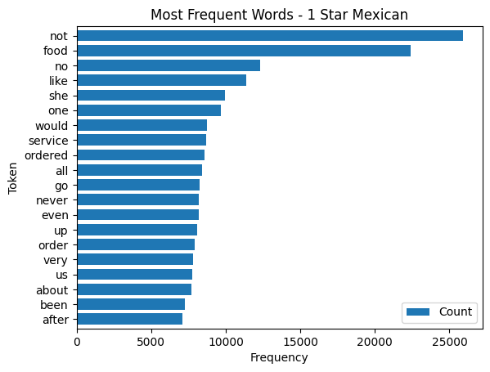
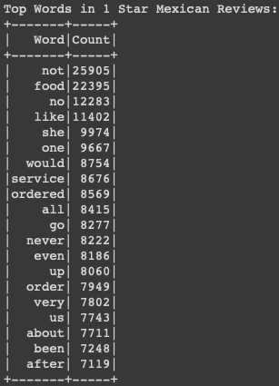

Slide 7
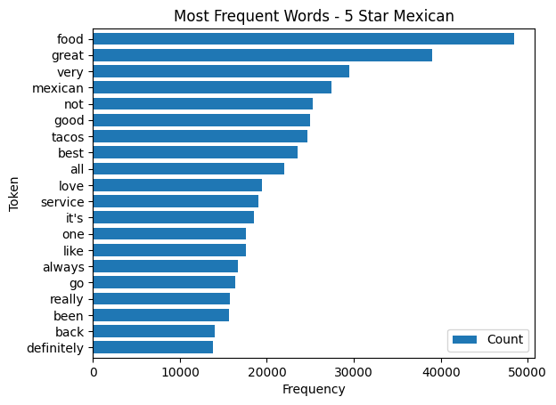
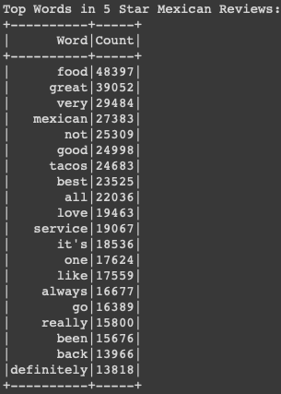

Slide 8
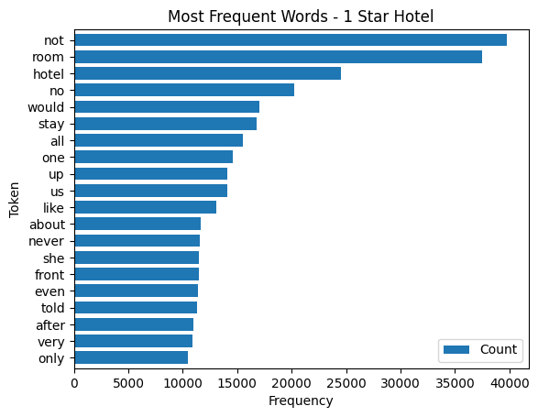
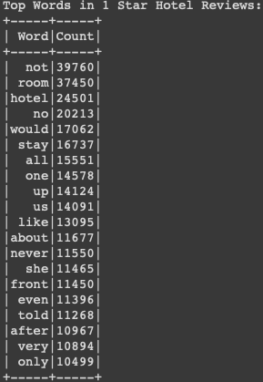

Slide 9
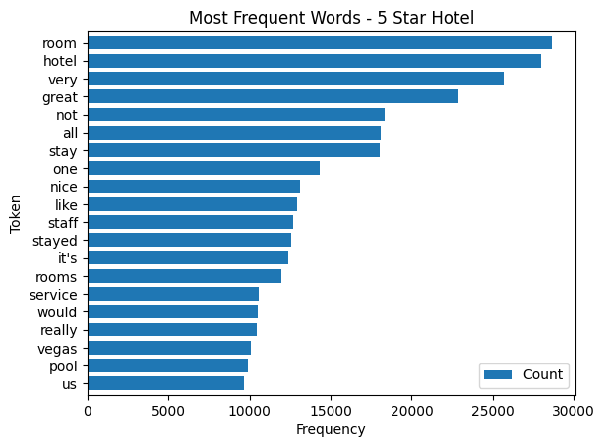
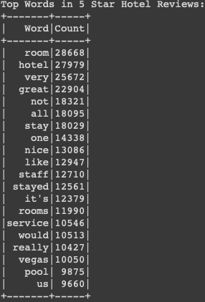

Slide 10

Streaming and Sentiment Analysis

Slide 11
Results
We observe repetition of certain words in the different categories for both the 1 star and 5 star reviews.
By determining the most frequent words in the good and bad reviews, we were able to confirm the accuracy of the sentiment assigned by the model.

Slide 12
Thank
you

